Slide 1
Shri Shankaracharya Institute of Professional Management & Technology, Raipur
Major Project Report on
Listen Up: Audiobook And Music Player Web Application
CSE 7th Semester
Department of Computer Science and Engineering,
Batch 2019-2023
Session Sept 2022 – Jan 2023
Presentation Date: -

Slide 2
Index
Application Area
Project Overview
Project Requirements
Database Details
Back End & Front End
Project Flow Diagram
Data Flow Diagram
Snapshot
Result & Conclusion
References

Slide 3
Application Area
The purpose of our project is to automate the existing manual system by the help of computerized equipment and full-fledged computer software, fulfilling their requirements, so that their valuable data/information can be stored for a longer period with easy accessing and manipulation of the same. The required software and hardware are easily available and easy to work with. Our web application can lead to error free, secure, reliable and fast management system. It can assist the user to concentrate on their other activities rather to concentrate on the record keeping. Thus it will help organization in better utilization of resources. The organization can maintain computerized records without redundant entries. That means that one need not be distracted by information that is not relevant, while being able to reach the information. The aim is to automate its existing manual system by the help of computerized equipment and full-fledged computer software, fulfilling their requirements, so that their valuable data/information can be stored for a longer period with easy accessing and manipulation of the same. Basically the project describes how to manage for good performance and better services for the clients.

Slide 4
Project Overview
The "ListenUp: Audiobook and music player web application” has been developed to override the problems prevailing in the practicing manual system. This software is supported to eliminate and in some cases reduce the hardships faced by this existing system. The application is reduced as much as possible to avoid errors while entering the data. It also provides error message while entering invalid data. Thus by this all it proves it is user-friendly. Our web application can lead to error free, secure, reliable and fast management system. It can assist the user to concentrate on their other activities rather to concentrate on the record keeping. Thus it will help organization in better utilization of resources. Every organization, whether big or small, has challenges to overcome and managing the information of Album, Music/Audiobooks, Track, Customer, Album Type.

Slide 5
Project Requirements (Developer)
Software requirements
Operating System : Windows XP/7/8/8.1 or Linux
User Interface : HTML, CSS
Server-side Scripting : PHP Script
Client-side-Scripting : Java Script
Programming Language : PHP
Web Applications : XAMPP/WAMP/LAMP Server
IDE/Workbench : Visual Studio Code
Database : MySQL
Server Deployment : Apache
Hardware requirements
Processor: Intel dual core or above
Processor Speed:1.0GHZ or above
RAM: 1 GB RAM or above
Hard Disk: 40 GB hard disk or above
Operating system: Windows 7 or above

Slide 6
Database Details
 | Tables | Table Attribute
1. | Albums | id, title, artist, genre, artworkPath
2. | Artist | id, name, description, imageUrl
3. | Genres | id, name
4. | Playlists | id, name, owner, dateCreated
5. | Playlistsongs | id, songid, playlistId, playlistOrder
6. | Songs | id, title, artist, artist1, artist2, artist3, artist4, album, genre, duration, path, albumOrder and plays
7. | Users | id, username, firstName, lastName, email, password, type, signUpDate, profilePic
Tables | Attributes

Slide 7
Back End & Front End
Front End:
PHP
HTML
CSS
JavaScript
Back End:
1. MYSQL 5.0

Slide 8
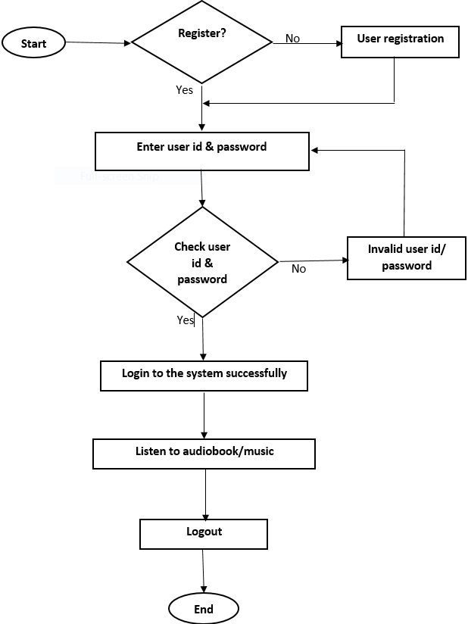
Project Flow Diagram
Flow Chart

Slide 9
Data Flow Diagram
The DFD takes an input-process-output view of a system i.e data objects flow into the software are transformed by processing elements, and resultant data objects flow out of the software.
Data objects represented by labelled arrows and transformation are represented by circles also called as bubbles. DFD is presented in hierarchical fashion. The first data flow model represents the system as a whole. Subsequent DFD refine the context diagram(level 0 DFD) providing increasing details with each subsequent level.

Slide 10
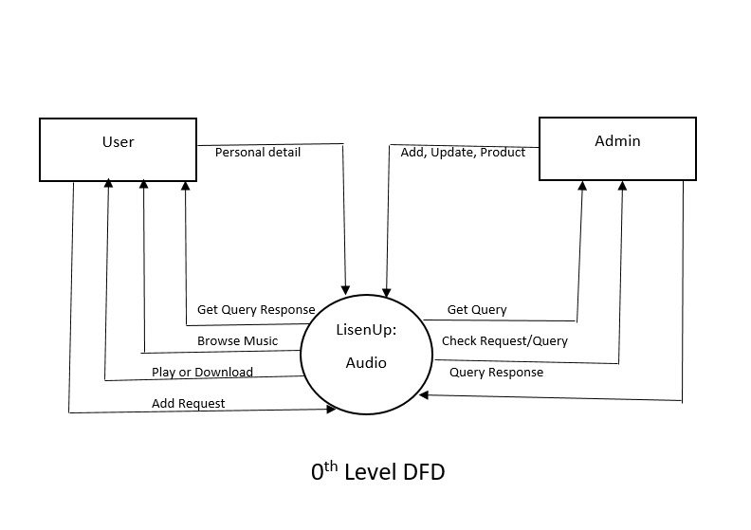

Slide 11
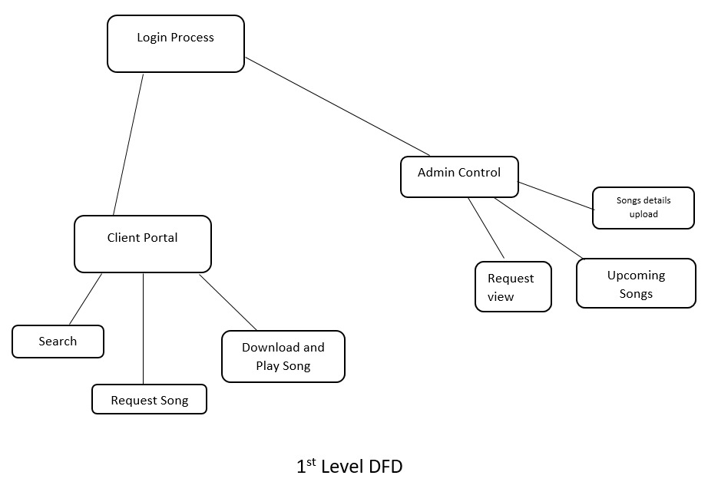

Slide 12
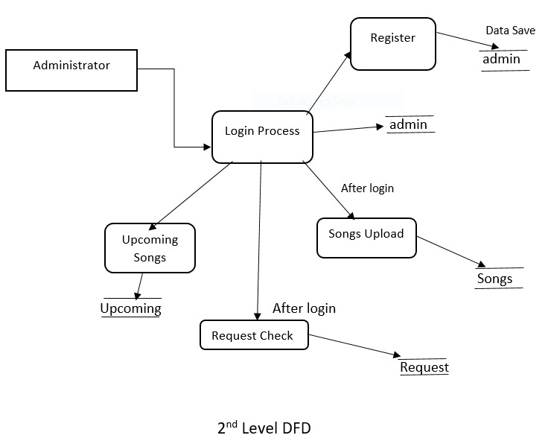

Slide 13
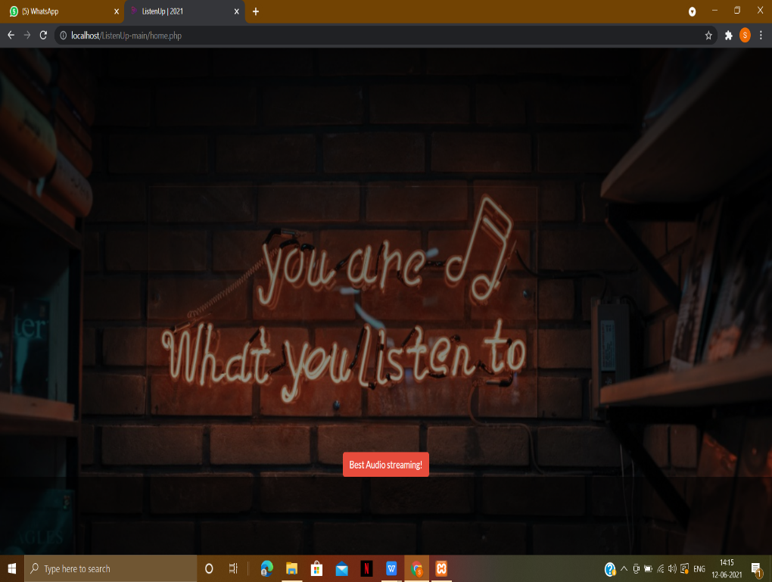
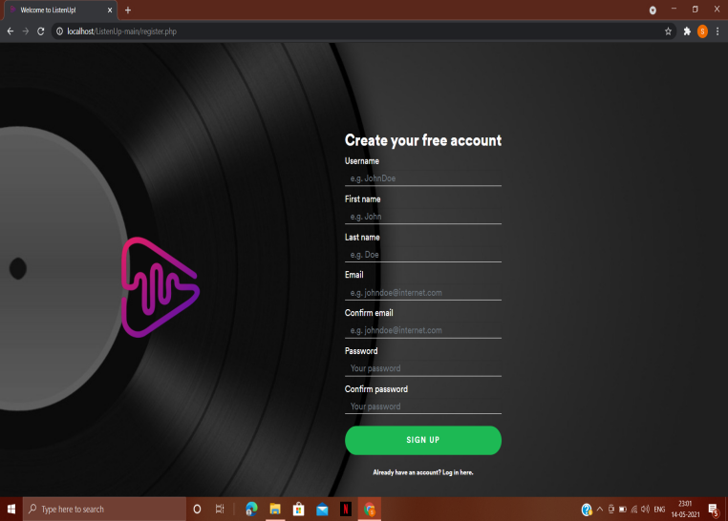
Snapshot

Slide 14
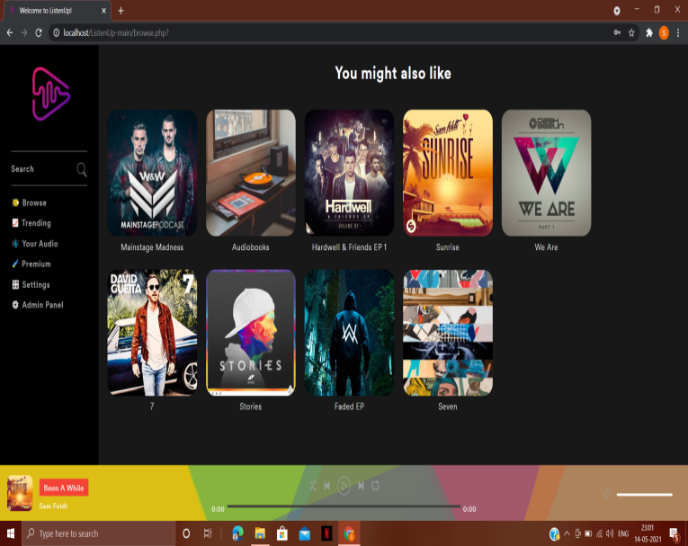
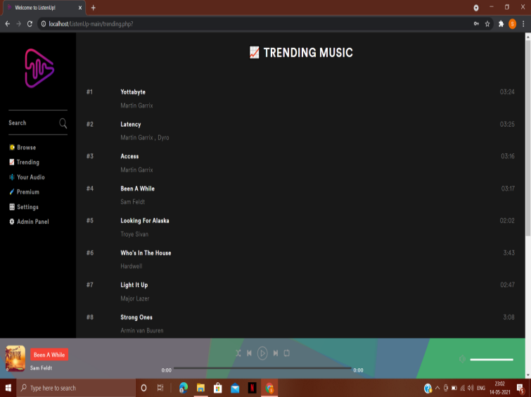

Slide 15
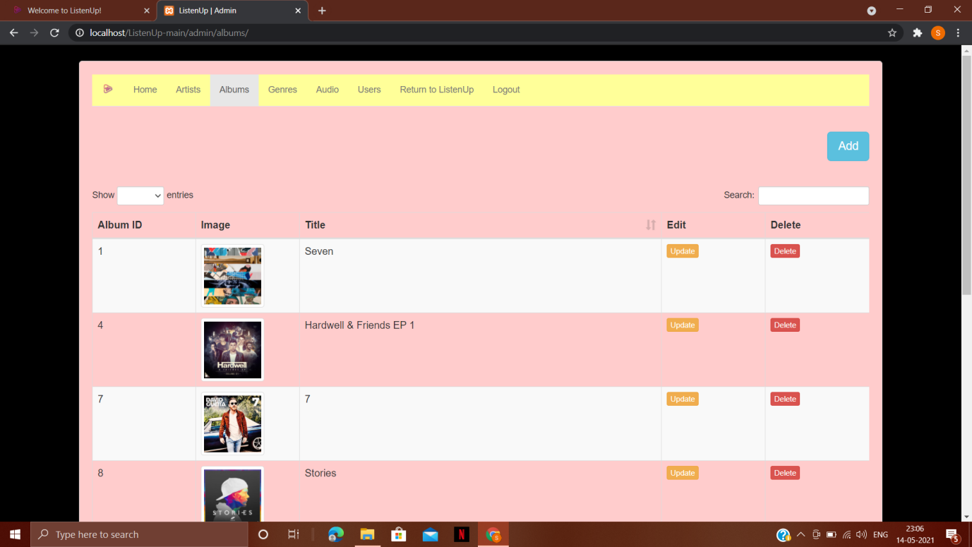
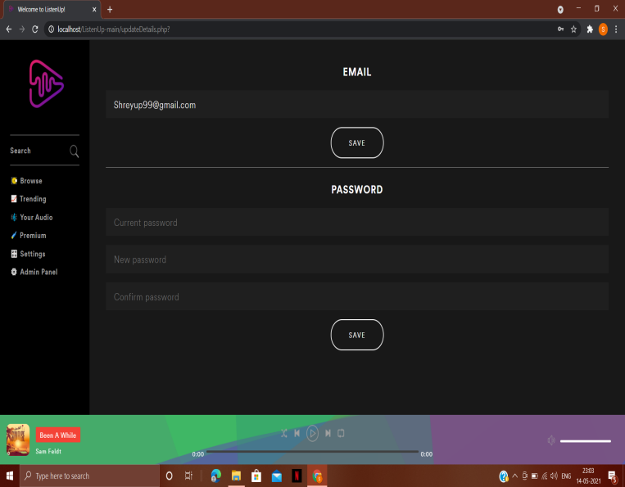

Slide 16
Result & Conclusion
Through this package we provide a fully customized web application. This system is an automated system so that the functional working of it is effective and time saving. In this modern era time is the most precious thing, so in context of time the new system will be effective to do a group of task in easy and secure manner.
It may help collecting perfect management in details. In a very short time, the collection will be obvious, simple and sensible. It will help a person to know the management of passed year perfectly and vividly. It also helps in current all works relative to ListenUp: Audiobook and Music Player Web Application. It will be also reduced the cost of collecting the management & collection procedure will go on smoothly. Our project aims at Business process automation, i.e. we have tried to computerize various processes of ListenUp: Audiobook and Music Player Web Application. In computer system the person has to fill the various forms & number of copies of the forms can be easily generated at a time.

Slide 17
References
Web Resources
https://www.tutorialspoint.com/php
https://www.w3schools.com/html
https://www.w3schools.com/css
https://www.javatpoint.com/mysql-tutorial
https://www.udemy.com/course/php-for-complete-beginners-includes-msql-object-oriented/

